Slide 1
Gihan Shamike Liyanage

Slide 2
___yes___?
___yes___?
___yes___?
___yes___?
___yes___?
___yes___?
___yes___?
___yes___?
___yes___?
___yes___?
___yes___?
___yes___?
___yes___?

Slide 4



Slide 5



Slide 7



Slide 8

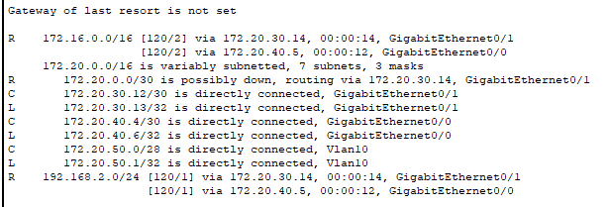

Slide 9
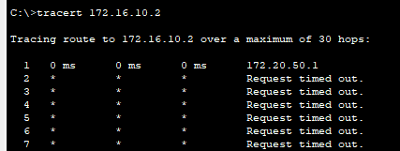
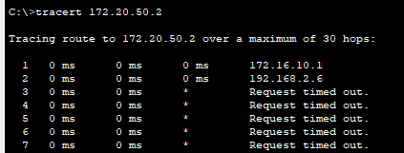
No

Slide 11



Slide 12
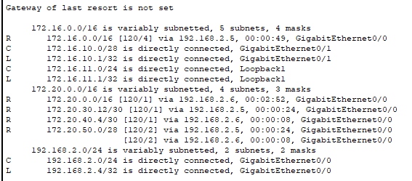
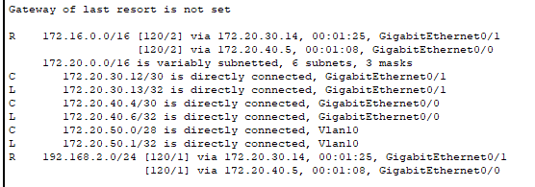

Slide 13
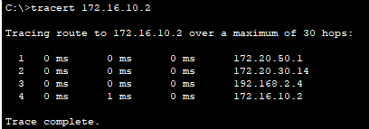
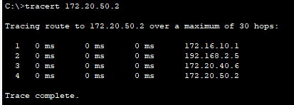
Yes

